Slide 1


Business Process management
Project presentation
Group K:
Gabriel Felipe Martins de Souza | m20210598
Luiz Humberto Polaro Vizeu | m20210554
Rogério Domingos Paulo| m20210597
Tongjiuzhou Liu | m20211012
June/2022

Slide 2
CONTENT
PROBLEM DESCRIPTION
OBJECTIVES
Process discovery
PROCESS ANALYSIS
PROCESS REDESIGN
RESULTS

Slide 3

Problem DESCRIPTION
Financials
Patient dissatisfaction
LACK OF COMMUNICATION
The process is time consuming and involves uncertainty on how long in going to take
Clinic staff does not know how to answer time/schedule related patient’s questions
Sometimes the patients make a mistake on the day and time of the medical appointment due to the lack of a more efficient communication service between the patient
and the hospital
Huge opportunity costs losses on unattended clients (no cash entering)
Costs
TECHNOLOGY
Costs on non-essential supply equipment and idle time resources
Low / bad use of technological tools

Slide 4




OBJECTIVES
USE BUSINESS PROCESS MANAGEMENT
FOCUS ON ORTHOPEDICS DEPARTMENT
Use BPM’s ​methods, techniques and tools to discover, analyze, redesign, execute and monitor a typical medical consultation
Addressing the orthopedic department problems can be a way to spread thru other hospital’s areas
Cost savings
CUSTOMER SATISFACTION
Reduce expenses of supplies and enable process / resources runs more efficient
Improve the patient flow in the hospital and the entire patient
Experience making it more enjoyable and simpler

Slide 5

PROCESS DISCOVERY

Slide 6
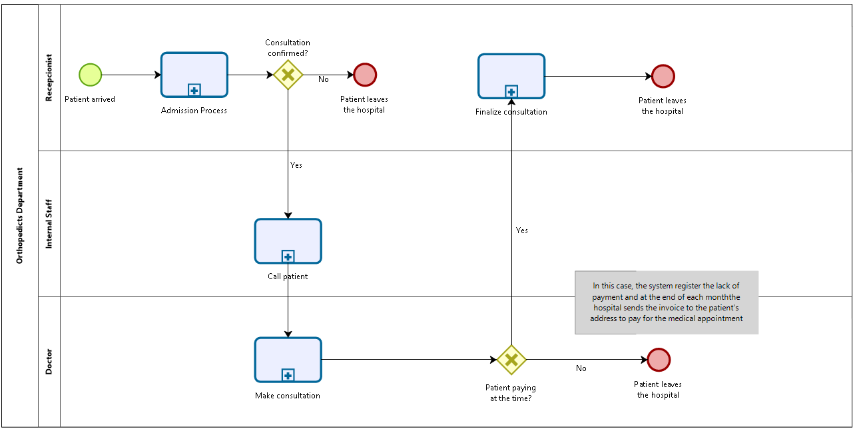
THE AS-IS MODEL
Receptionist | Internal Staff | Doctor
Receive patient on the desk | Verify medical availability | Attend the patient
Ask for patient Citizen Card and medical consultation | Direct patient to Doctor's office | Register prescription into system
Insert patient personal data into the system |  | Register exams into the system
Confirm consultation |  | Print the exams prescription
Receive the payment from patient
Sign papers with hospital signature
Print justification for the patient
Deliver all necessary papers to the patient
AS-IS MODEL OVERVIEW
MAIN TASKS OF THE PROCESS
Notes:
Some assumptions have been made to support the As-Is modeling, particularly regarding the decision point after the Make Consultation sub-process. In this case, it is considered that the patient leaves the hospital right after the consultation ends, which means that the patient does not return to the reception but decides to exit the building not only refusing to pay at the time, but also without making any further requests (justifications, new appointments, stamped prescriptions, and others)

Slide 7

PROCESS ANALYSIS

Slide 8
QUALITATIVE ANALYSIS
“Qualitative process analysis techniques allow us to identify, classify, and understand weaknesses and improvement opportunities in a process” (Dumas, M., La Rosa, M., Mendling, J., Reijers, H.A., 2018).
Notes:
“Qualitative process analysis techniques allow us to identify, classify, and understand weaknesses and improvement opportunities in a process” (Dumas, M., La Rosa, M., Mendling, J., Reijers, H.A., 2018).
In the next sections, a set of qualitative process analysis is going to be performed to evaluate the process under different perspectives, such as Value-Adding Analysis, Waste Analysis, and Issue Register. At the end, the decision on which activities and tasks must be kept or eliminated tends to be smoother.

Slide 9
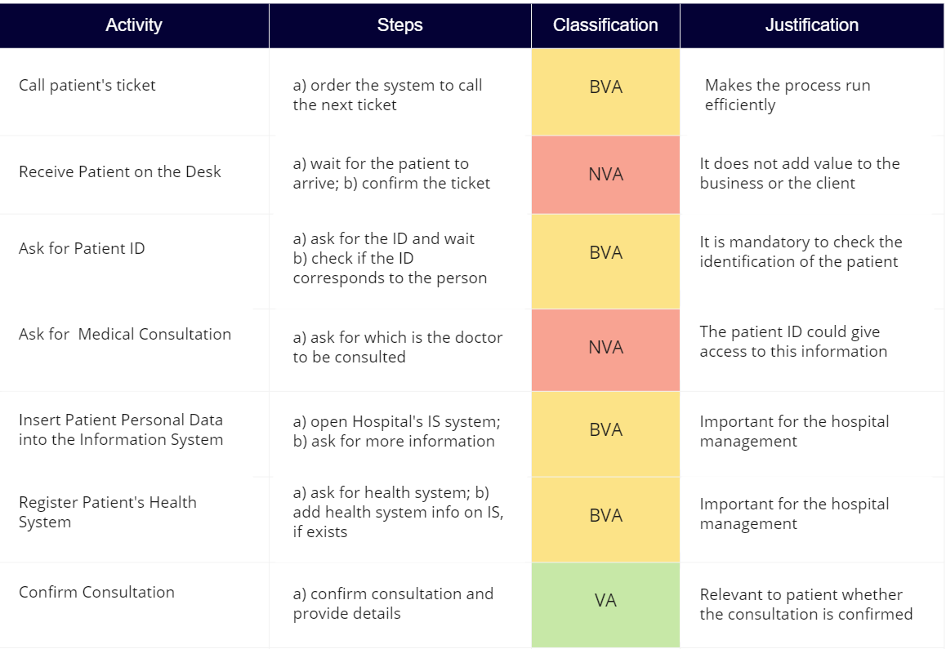
QUALITATIVE ANALYSIS
Value-added analysis
Admission Process - Receptionist
Notes:
Value-added analysis aims to identify unnecessary parts of the process that can be eliminated. Following, each activity of the subprocesses is going to be decomposed into steps and classified from the value-adding perspective.

Slide 10
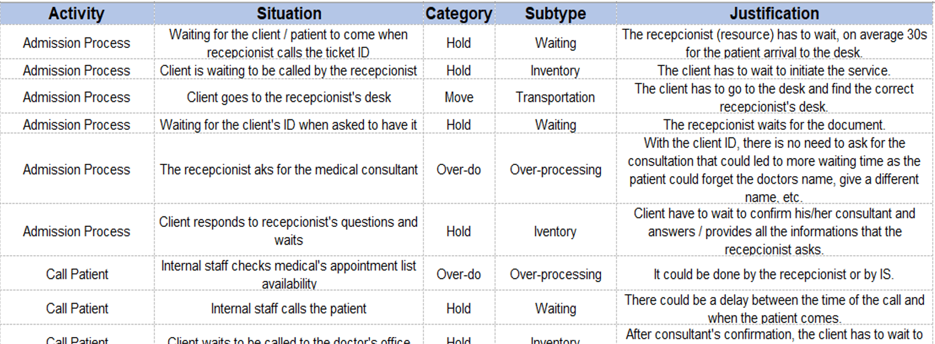
QUALITATIVE ANALYSIS
WASTE ANALYSIS
.
.
.
.
Notes:
The Waste Analysis is a method focused on finding wastes throughout processes, and can be grouped into three categories: Move, Hold, and Overdo.

Slide 11
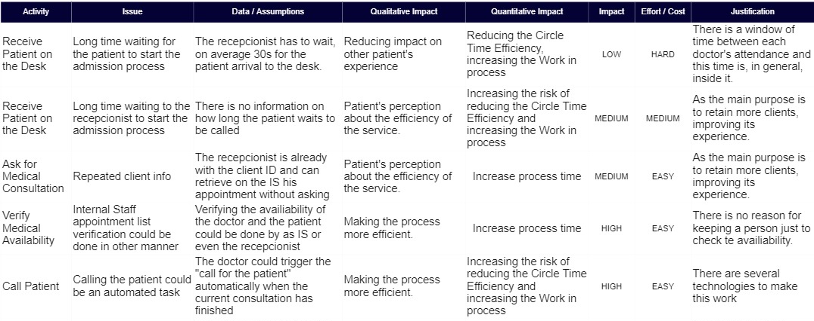
QUALITATIVE ANALYSIS
ISSUE REGISTER
.
.
.
.
Notes:
The Issue Register aims to maintain, to organize and to prioritize identified weaknesses within the business process.

Slide 12
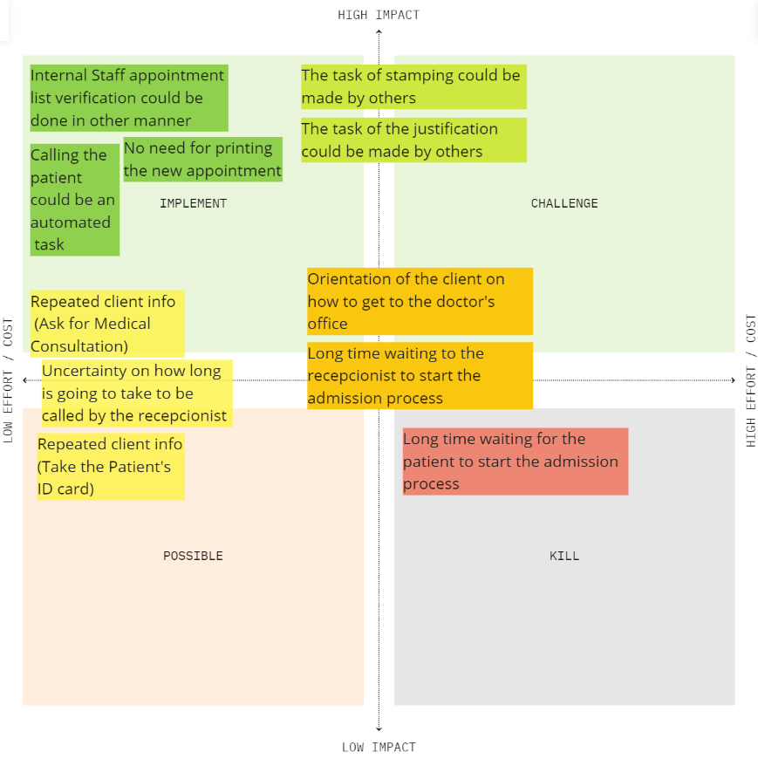
QUALITATIVE ANALYSIS
PICK CHART
Notes:
From the Issue Register, a Pick Chart was raised to better illustrate the prioritization and which tasks must be eliminated or modified in order to increase the process efficiency from a qualitative perspective.

Slide 13
QUANTITATIVE ANALYSIS
Techniques for analyzing business processes quantitatively in terms of process performance measures such as cycle time, waiting time, cost, and resource utilization.

Slide 14
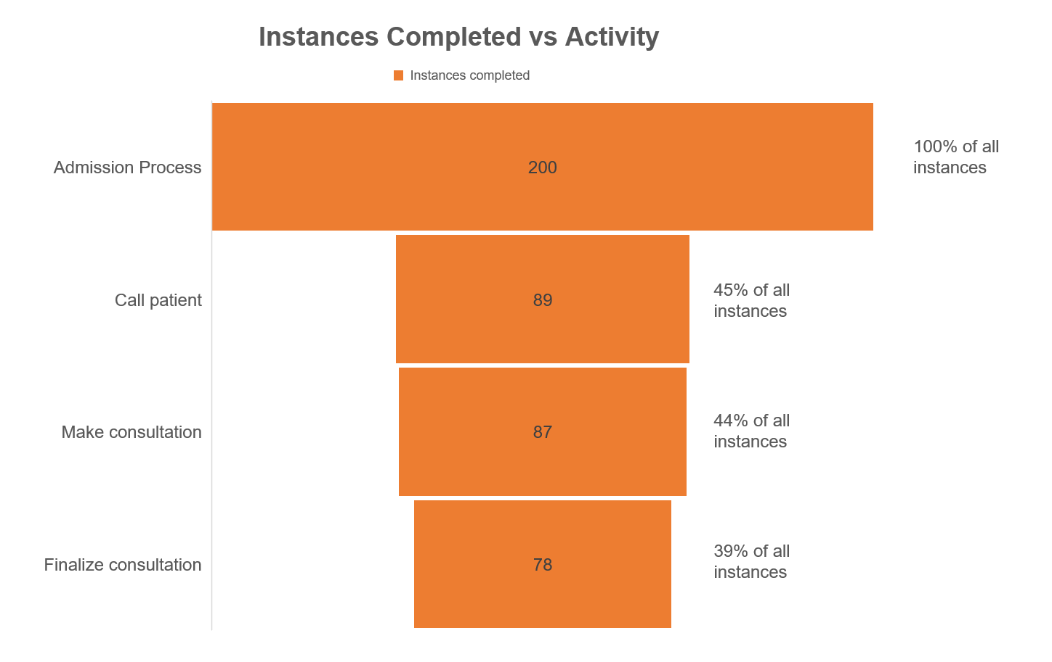
QUANTITATIVE ANALYSIS

Slide 15
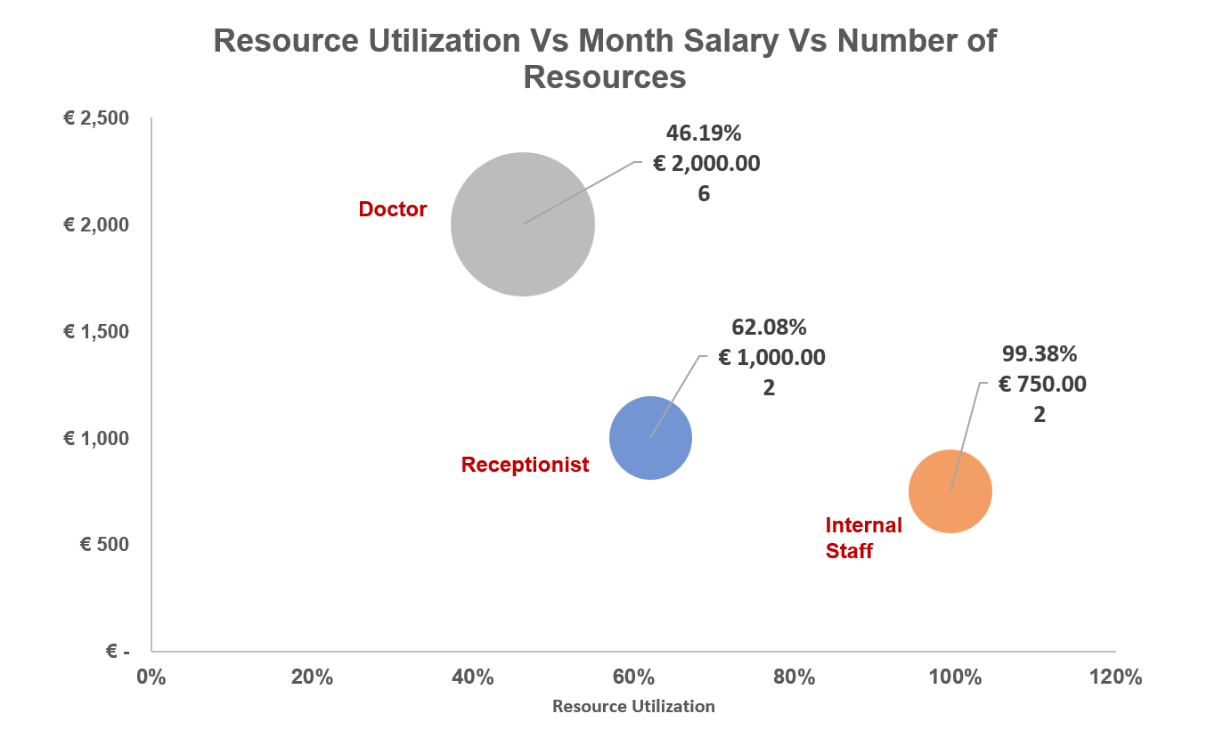
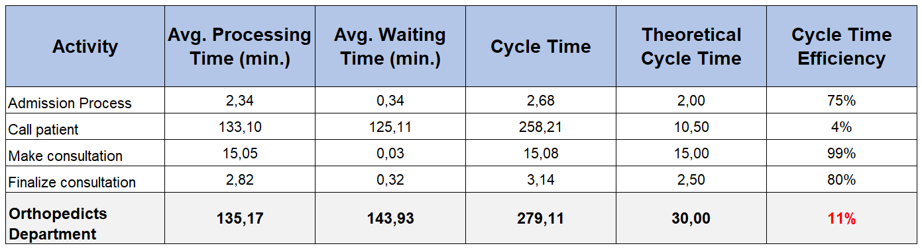
QUANTITATIVE ANALYSIS
Cycle Time Efficiency for As-Is Model

Slide 16

PROCESS REDESIGN

Slide 17
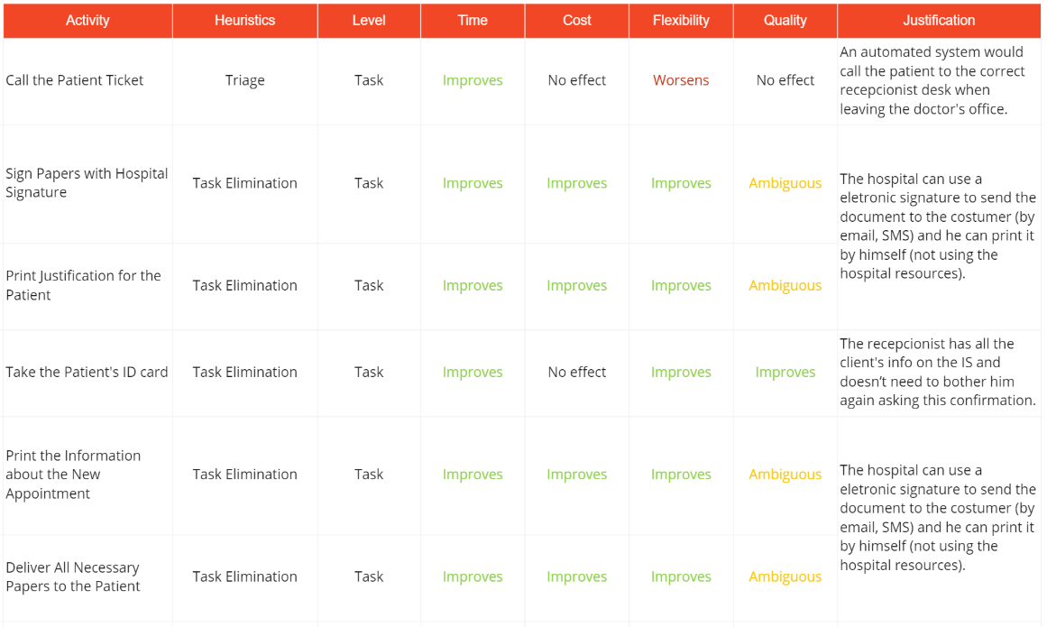
Exploitative Redesign approach
Finalize Consultation Process - Redesign
Notes:
To proceed with the prescriptive modeling of the To-Be model, the Exploitative Redesign approach was adopted. Its objective is to identify problems within the system, and to solve them incrementally. The redesign was focused on bringing improvements under the perspective of cost, time, quality, and flexibility. From the many different heuristics applied regarding the task, flow, and process levels, the ones that brought more impact were the Heuristic 1 (task elimination) and the Heuristic 9 (automation), which is based on task-level and process-level, respectively. Following each activity is going to be classified, using the heuristics approach.

Slide 18
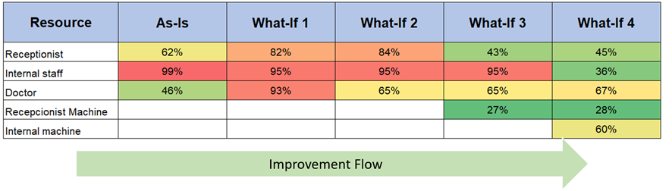
WHAT-IF Analysis
What-if 1 - based on As-Is: reducing the average time from 10.5 min to 5 min in the activity Call Patient.
What-if 2 - based on What-if 1: reducing the average time from 15 min to 10 min in the activity Make Consultation.
What-if 3 - based on What-if 2: adding three receptionist machines on Admission process and using a gate “OR” to parallelize the task into more resources.
What-if 4 - based on What-if 3: adding two internal machines on the activity Call Patient and using a gate “OR” in the resource option.
Notes:
What-if analysis is about making changes on the simulation parameters, by adding or removing resources, and re-running the simulation. Starting from the results obtained in the As-Is model simulation, four different What-if scenarios were performed to improve the baseline efficiency. What-if 1 - based on As-Is: reducing the average time from 10.5 min to 5 min in the activity Call Patient.
What-if 2 - based on What-if 1: reducing the average time from 15 min to 10 min in the activity Make Consultation.
What-if 3 - based on What-if 2: adding three receptionist machines on Admission process and using a gate “OR” to parallelize the task into more resources.
What-if 4 - based on What-if 3: adding two internal machines on the activity Call Patient and using a gate “OR” in the resource option.

Slide 19
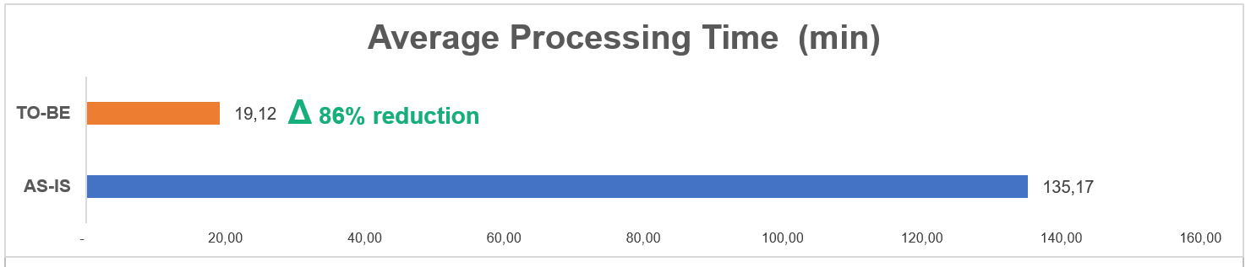
Flow Analysis
Average Processing Time To-Be vs As-Is
Instances Completed / Activity To-Be vs As-Is
Notes:
Flow analysis is a family of techniques that allow to assess the global performance of a process given some knowledge about the performance of its activities. Following, the principal metrics such as Average Processing Time, Average Waiting Time, Cycle Time, and Working in Progress, will be used to compare the results between the To-Be model and the As-Is model.
An increase of 117% in the number of instances completed and 169 patients finish their medical consultations in the Grace Hospital on the TO-BE model.
The average processing time of the To-Be model presented a reduction of 86% when compared to the As-Is model. The activity Call a Patient had its average processing time decreased from 133 minutes to 5 minutes, which mostly contributed to the overall performance improvement.

Slide 20
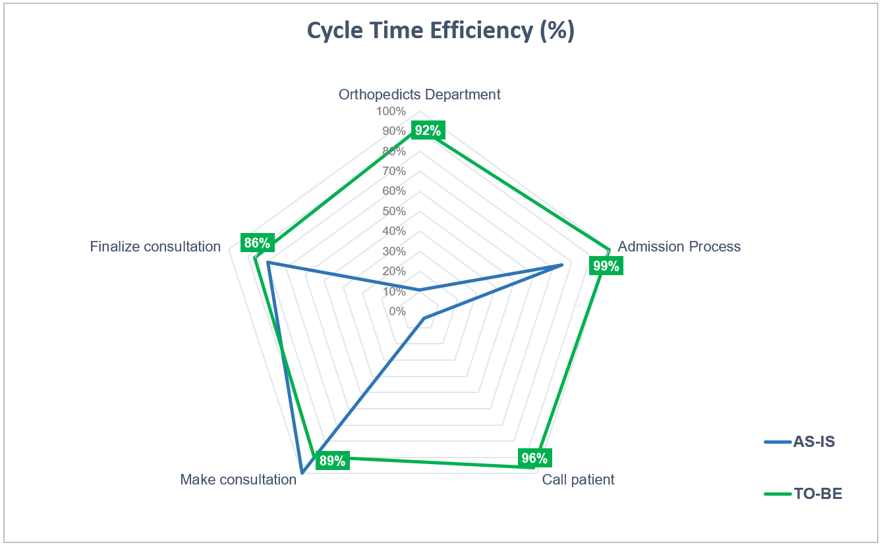
Flow Analysis
Cycle Time Efficiency To-Be vs As-Is
Notes:
From the following radar plot, it is visible that the cycle time efficiency increased in virtually in all the activities within the department and reached an overall improvement of 753% compared to the prior efficiency of the As-Is model.

Slide 21
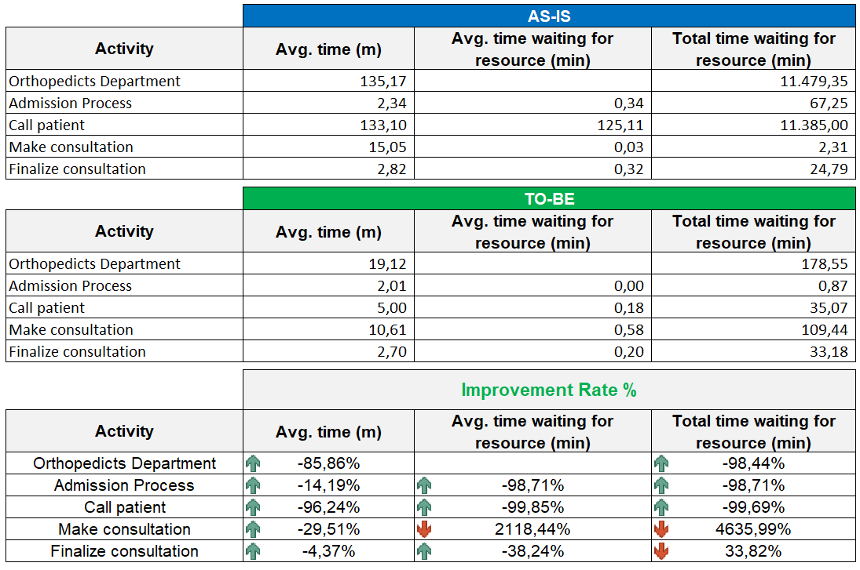
Queuing Analysis
Queue Analysis in a View To-Be vs As-Is
Notes:
Flow analysis does not consider waiting times due to resource contention, therefore a queuing analysis was made to overcome these limitations and give a broader solution

Slide 22

RESULTS

Slide 23
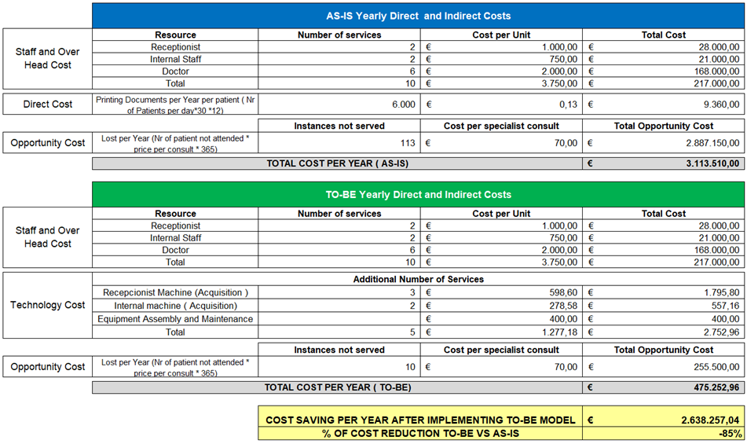
COST-BENEFIT ANALYSIS
Cost-benefit Analysis
Notes:
Cost-benefit is a financial metric that is widely used to measure the probability of gaining a return from an investment. It is a ratio that compares the gain or loss from an investment relative to its cost. It is as useful in evaluating the potential return from a stand-alone investment as it is in comparing returns from several investments. Is this case, a comparison of the As-Is and To-Be model is going to be placed, considering all the modifications in the second model, acquisition of new technologies, processes performance and opportunities improvements. More detailed information about the assumptions and the source used to calculate the return on investment can be obtained in the references.
By implementing the improvements addressed in the To-Be model, they could get a cost reduction of 85%, compared to the current state. The opportunity cost of patients leaving the Hospital without making a consultation seems the biggest problems, which affects potentially the Hospital finances.

Slide 24

CONCLUSION
BPM lifecycle methodology
To-Be model advantage against the current model (As-Is)
Minimize Ambiental impact
Notes:
After all the many analyses that helped understanding the opportunities, and the process redesign phase, the To-Be model demonstrated a large advantage against the current model (As-Is), not only because of the efficiency in the optic of Time, Quality, but also under the financial perspective, which was reinforced by the Cost-benefit analysis. Also, the Ambiental impact was considered in the project, considering the paper and print toner that can be avoided if the Hospital decides on moving with the implementation.

Slide 25

Thank you
Group K:
Gabriel Felipe Martins de Souza | m20210598
Luiz Humberto Polaro Vizeu | m20210554
Rogério Domingos Paulo| m20210597
Tongjiuzhou Liu | m20211012
​

